Slide 1
Basic Macro/Script Writing for Nextest
SSABBAH

Slide 2
Introduction
It is often true that we want to perform many (repetitive) commands on a unit for testing purposes; to facilitate this, macros and scripts can be run on the tester to issue all of the needed commands without someone needing to sit there and issue every one.
Macros are simply text files that contain (almost) exactly the same syntax as is used on the tester to issue commands.
Pros: easy to write; good for performing simple commands many times.
Cons: not very helpful for iterating over several different commands, or repeating those commands on an arbitrary list of blocks
Scripts are written in Perl and have a special function for calling tester commands.
Pros: easy to perform the same commands for multiple cases by using loops and other logic.
Cons: a basic knowledge of Perl is needed to make using this worthwhile.

Slide 3
Using and Writing Macros

Slide 4
Using Macros
Basic Nextest commands are really just macros- you’ve already been using them.
Can change the macro directory on the tester by issuing setpath(macros, <PATH>)
Clicking on “Commands” and then “Macros” will show all available macros in the current directory. You can then click on which macro you’d like to run and it will be loaded in the CLI for you.
Macros can take arguments- it may be helpful to open the macro in Notepad or another text editor to see what arguments, if any, it takes (some macros may have a help command built in, but don’t bet on it).
Be aware that macros won’t print the commands they’re executing to the CLI- only the output of those commands (this is something to keep in mind when writing macros, too).

Slide 5
Writing Macros
Can be done in any text editor, or by typing define(macro_name) into the CLI. This will bring up the tester’s own text editor, and will save the macro to the current macro directory.
Basic structure:
macro_name(arg = default_value)
# Comments preceded by hash mark/pound symbol
# tester commands follow, almost exactly as you would type them in the CLI.
pd;pu;rst;rs
be(arg,,1)
loadpat(IRP)
pgm(arg, 0, arg, 1023, 0, 1800, 0)
….
….

Slide 6
Writing Macros
The macro will let you know if you have an error when you try to run it; the macro won’t execute any of the commands unless your syntax is correct all the way through.
Otherwise, the macro will execute all of its commands until completed.
What if you want to execute exactly the same command many times? Try the following:
100(be(0,,1);pgm(0, 0, 0, 1023, 0, 18591, 0))
What do you think this will do?

Slide 7
Writing Macros
Variables (such as your arguments) can be manipulated within the macro using braces:
cycle_100_times(blk = 0)
{blk1, blk+1} #creates variable blk1, initializes it to blk + 1
{blk2, blk+2} #creates variable blk2, initializes it to blk + 2
loadpat(irp)
100(be(blk,blk,0);pgm(blk, 0, blk, 1023, 0, 18591, 0))
100(be(blk1,blk1,0);pgm(blk1, 0, blk1, 1023, 0, 18591, 0))
100(be(blk2,blk2,0);pgm(blk2, 0, blk2, 1023, 0, 18591, 0))
100(be({blk+3}, {blk+3} ,0);pgm({blk+3} , 0, {blk+3} , 1023, 0, 18591, 0))
# This last line doesn’t actually create a new variable, but it does cycle blk + 3 # 100 times!

Slide 8
Writing Macros
The lineout() command will print text to the CLI.
Good idea to include in your macros to help the overall tester output make sense
lineout(“This line will get printed to the CLI when the macro reaches it.”)
If no argument is provided, the command will be a carriage return. This can be good for putting space between sets of commands.

Slide 9
Writing Nextest Scripts

Slide 10
Writing Scripts
Scripts are much more powerful than macros due to their ability to loop through commands
This means the commands themselves take much less time to write up!
…but writing these scripts requires at least a basic understanding of Perl. Learning Perl is outside the scope of this training, but Micron has some excellent resources, one of which can be found here:
http://edc.micron.com/mtv/PQA001/_layouts/15/WopiFrame.aspx?sourcedoc=/mtv/PQA001/TRAIN/Tech_Lecture_PQA_Perl_101.pptx&action=default&DefaultItemOpen=1
Try searching MERC for additional resources!
You don’t need to be a Perl guru to write scripts for Nextest- a basic understanding of programming principles will be enough to do what you need to.

Slide 11
Writing Nextest Scripts
A quick plug for a good text editor…
Notepad works great for writing macros because the syntax isn’t very involved, and you won’t be working with lots of variables, arrays, keywords, etc….
….but that’s not true for Perl scripts. Getting a good editor (such as Notepad++) will be very helpful for writing these scripts- that’s because Notepad++ will color-code your keywords, variables, arrays, etc that will make it easier to read and debug your code.
The examples given in this document will show screen shots of the scripts taken from Notepad++
Note that the testers all have Scite installed- this is another text editor that’s very useful for making tweaks to your scripts while you’re at the tester. It also has a major advantage over Notepad++: it will check your syntax to make sure it’s right!

Slide 12
Writing Scripts
Like macros, comments are preceded by a hash/pound symbol.
Basic structure of a Perl script for Nextest:
#script_name.pl
#Comments about how to use the script, author name, etc.
#May also need to include something about it being Micron Confidential (fair warning)
#The following lines are required for just about any script you would be writing for the tester:
use strict;
use warnings;
BEGIN
{
unshift (@INC, \\perl_modules);
}
use runcli; #Runcli is the command that you’ll use to communicate with the tester
#Variables/Constants
#Commands

Slide 13
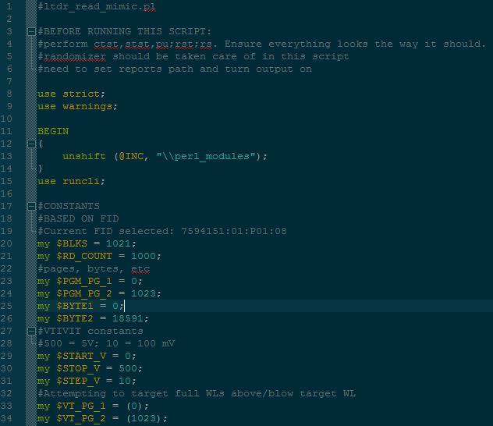
Opening Lines- Example
Notes on script and what should be done prior to using it (if anything)
Mandatory first lines
Defining constants. Here, anything in ALL CAPS is a constant

Slide 14
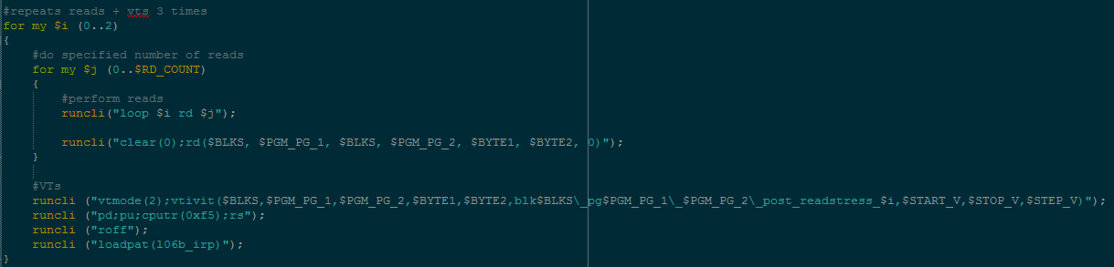
Opening Lines- Example
Nested for-loop. Good luck doing this in a macro!
Variables and constants can be written write into the commands!
Arguments of runcli() are the commands to the tester. These need to be included in quotation marks!

Slide 15
Writing Scripts
As with any programming language, comments are your friends!
You might think you’ll remember what your script does in 3 months, but you won’t. Do yourself (and everyone else) a favor and explain it in your code.
Before running a script, open it in Scite on the tester and check for syntax errors.
Scripts can be terminated by pressing Ctrl + C during execution, just like any other tester command.
Print statements will print to the Perl console, not the tester CLI. To print something to the CLI, use runcli(“lineout()”)
This is VERY helpful for tracking how far into a loop the script is…otherwise you have no way of knowing.

Slide 16
Writing Scripts
Perl scripts can also take arguments if you want to add them
Refer to Perl learning resources to find out how to do this
Giving your script this ability is nice if someone is running it who isn’t comfortable with editing variables in the script…it’s also a good way to save time by not having to edit your script between each run!
You can also accomplish something similar by using arrays within your script, as long as you know what values you want to use ahead of time
As with any programming language, the best way to learn is by doing. Try writing a few basic scripts that do relatively easy things on the bench, such as cycling a block many times, or collecting VT distributions
You can also learn a lot by looking at existing scripts to see what other tricks you can do!

Slide 17
Questions?
Feel free to contact me! I don’t promise to know the answer, but hopefully I can at least point you in the right direction.
The internet is also full of answers (and Perl has been around for a long time)

